Slide 1
Chapter 23
Electric Potential

Slide 2
Learning Goals for Chapter 23
Looking forward at …
how to calculate the electric potential energy of a collection of charges.
the meaning and significance of electric potential.
how to calculate the electric potential that a collection of charges produces at a point in space.
how to use equipotential surfaces to visualize how the electric potential varies in space.
how to use electric potential to calculate the electric field.

Slide 3

Introduction
In one type of welding, electric charge flows between the welding tool and the metal pieces that are to be joined.
This produces a glowing arc whose high temperature fuses the pieces together.
The tool must be held close to the metal pieces in order to maximize the electric field.
Electric potential energy is an integral part of our technological society.

Slide 4
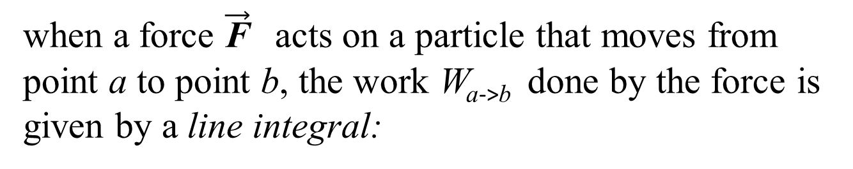
when a force $\vec{\text{F}}$ acts on a particle that moves from point a to point b, the work W_{a->b} done by the force is given by a line integral:

Slide 5
CONSERVATIVE FORCES
when you throw a ball up in the air, it slows down as kinetic energy is converted to gravitational potential energy. But on the way down the ball speeds up as potential energy is converted back to kinetic energy.
glider moving on a frictionless horizontal air track that runs into a spring bumper. The glider compresses the spring and then bounces back. If there is no friction, the glider ends up with the same speed and kinetic energy it had before the collision.

Slide 6
CONSERVATIVE FORCES
there is a two-way conversion from kinetic to potential energy and back. In both cases the total mechanical energy, kinetic plus potential, is constant or conserved during the motion.
A force that offers this opportunity of two-way conversion between kinetic and potential energies is called a conservative force.

Slide 9
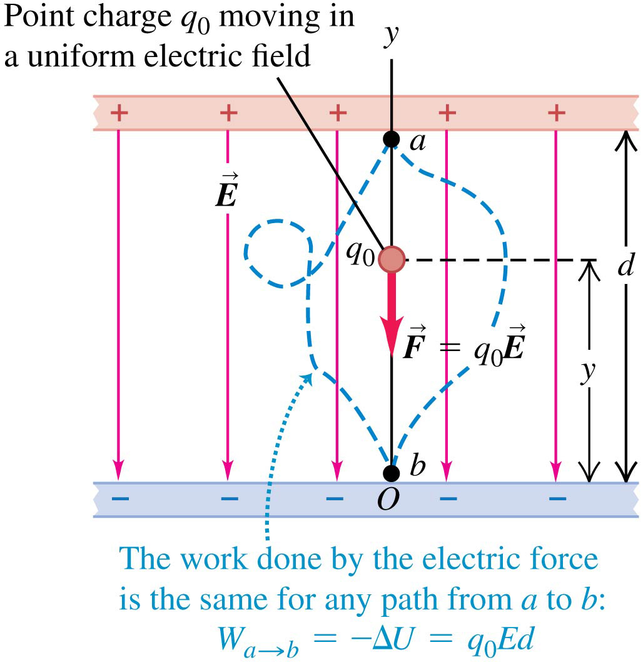
Electric potential energy in a uniform field
In the figure, a pair of charged parallel metal plates sets up a uniform, downward electric field.
The field exerts a downward force on a positive test charge.
As the charge moves downward from point a to point b, the work done by the field is independent of the path the particle takes.

Slide 10
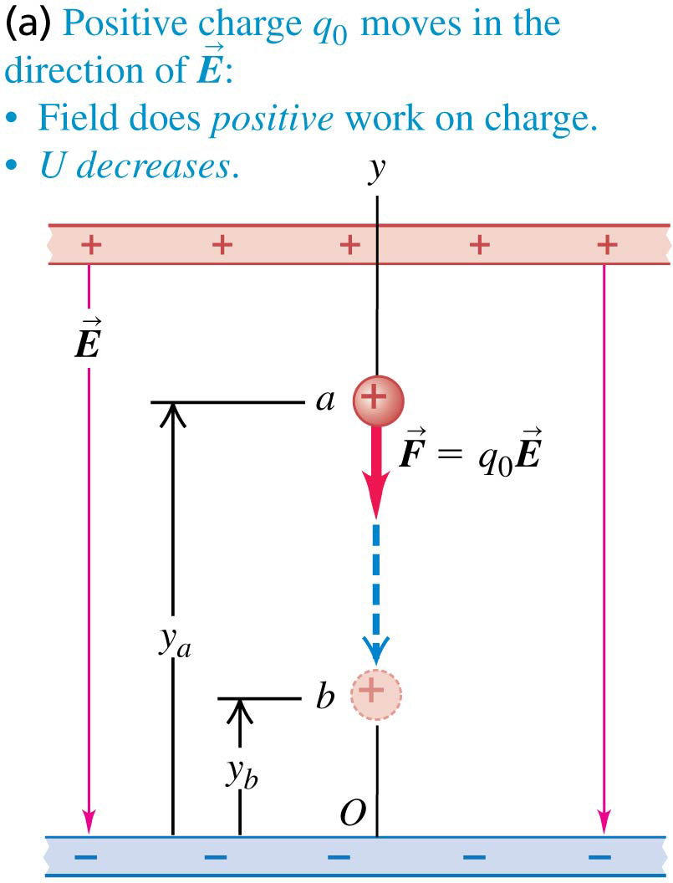
A positive charge moving in a uniform field
If the positive charge moves in the direction of the field, the field does positive work on the charge.
The potential energy decreases.

Slide 11
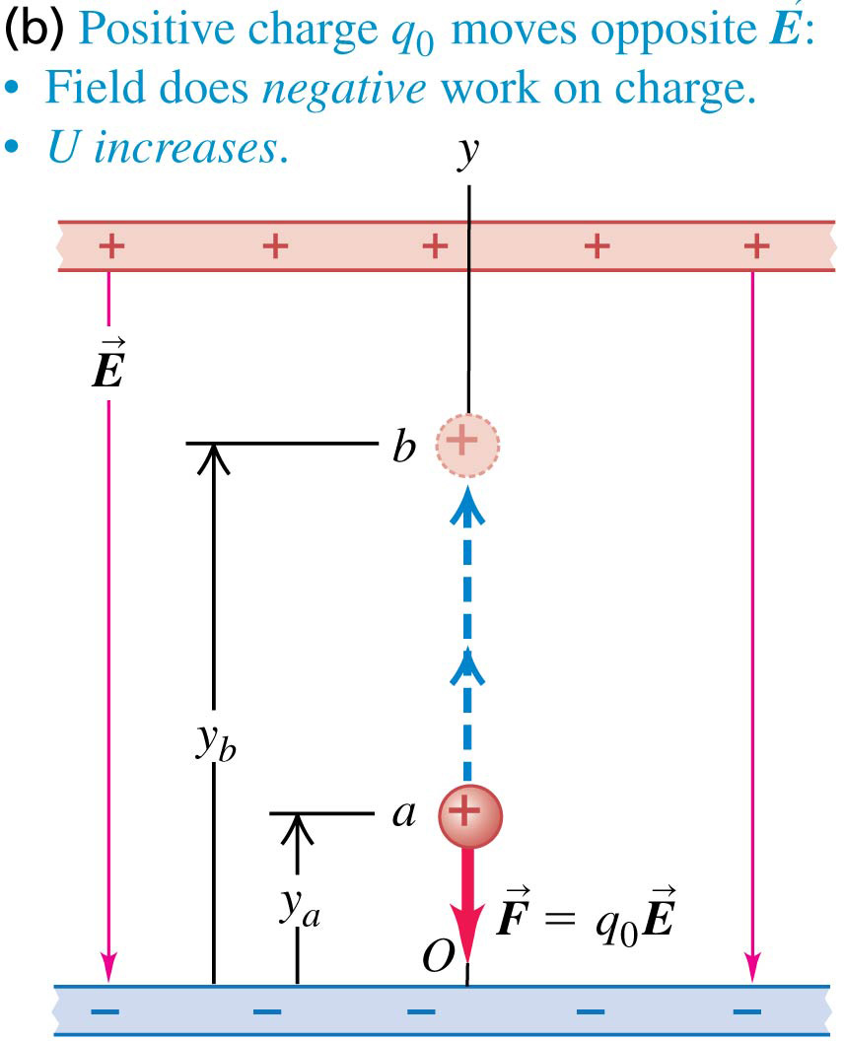
A positive charge moving in a uniform field
If the positive charge moves opposite the direction of the field, the field does negative work on the charge.
The potential energy increases.

Slide 12
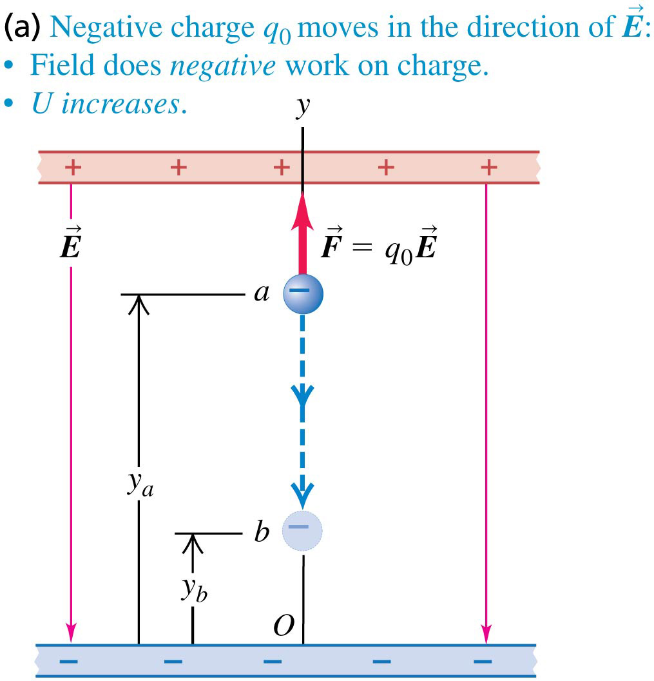
A negative charge moving in a uniform field
If the negative charge moves in the direction of the field, the field does negative work on the charge.
The potential energy increases.

Slide 13
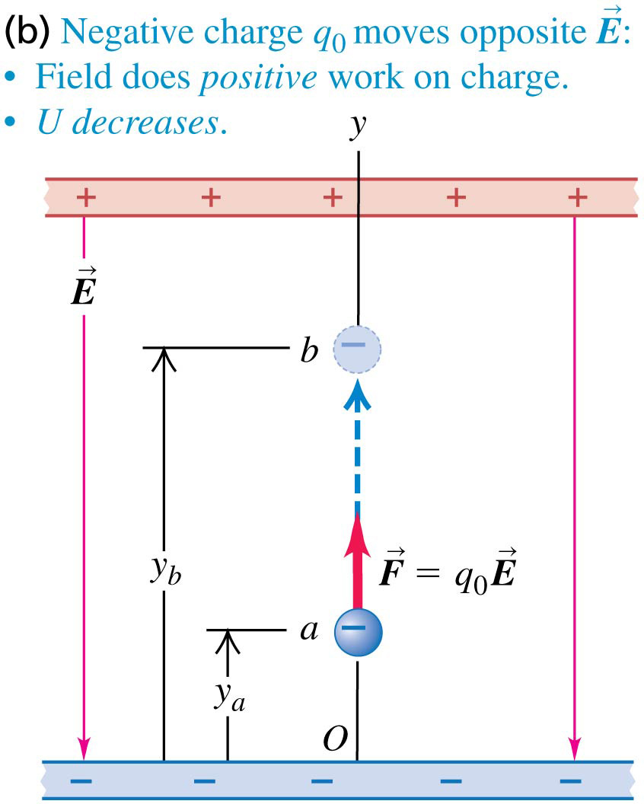
A negative charge moving in a uniform field
If the negative charge moves opposite the direction of the field, the field does positive work on the charge.
The potential energy decreases.

